Slide 1
<Team #15>
AI-Finance Platform
Transform the way you manage, invest, and grow — powered by AI.
R23EA110- Saurya Anand
R23EA121-Srinivas RC
R23EA109-Satyaprakash

Slide 2
Problem Statement
Refined solution:
The AI Finance Platform offers an intelligent and automated way to manage, analyze, and grow finances.
By integrating artificial intelligence, data analytics, and automation, the platform simplifies financial decision-making for individuals and businesses alike.
Automated Expense Tracking: Monitors and categorizes transactions in real-time.
Data Visualization: Presents complex data through clear, interactive charts and dashboards.
Problem Description / Motivation:
Most users face challenges like:
Lack of real-time insights into their income, expenses, and investments.
Difficulty in understanding financial data due to its complexity.
Manual and time-consuming processes for budgeting, tracking, and forecasting.
Limited access to personalized financial guidance without hiring experts.
The AI Finance Platform is motivated by the need to simplify financial management through automation, intelligent analysis, and actionable insights — helping users make smarter, data-driven financial decisions effortlessly.

Slide 3
Product/ Solution - Innovation
1.About the innovation:
The AI Finance Platform is an intelligent financial management system designed to help individuals and businesses manage their money efficiently through automation, data analysis, and artificial intelligence.
It provides a personalized digital assistant that tracks expenses, analyzes spending habits, forecasts future trends, and offers smart financial suggestions — all in one platform.
Simplifies Finance Management: Automates manual tasks like expense tracking and budgeting.
Provides Smart Insights: Uses AI to analyze financial patterns and recommend better saving and investment strategies.
Enhances Decision-Making: Offers real-time analytics and visual dashboards to help users understand their finances easily.
Saves Time and Effort: Reduces dependency on spreadsheets or manual calculations.

Slide 4
Product/ Solution - Innovation
2.How It Solves the Problems:
Simplifies Finance Management: Automates manual tasks like expense tracking and budgeting.
Provides Smart Insights: Uses AI to analyze financial patterns and recommend better saving and investment strategies.
Enhances Decision-Making: Offers real-time analytics and visual dashboards to help users understand their finances easily.
Saves Time and Effort: Reduces dependency on spreadsheets or manual calculations.
Promotes Financial Awareness: Educates users with AI-driven tips to improve money management.

Slide 5
Product/ Solution - Innovation
3. Types of Innovation:
Product Innovation
Introducing a new product or significantly improving an existing one.
Example: The AI Finance Platform uses artificial intelligence to provide real-time financial analysis, forecasting, and personalized insights — a major enhancement over traditional finance apps.
Business Model Innovation
Changing how value is delivered to customers or how revenue is generated.
Example: Offering AI-based financial tools as a subscription model or freemium service, allowing users to access advanced analytics at low cost.
Technological Innovation
Applying new or advanced technologies to solve existing problems efficiently.
Example: Leveraging machine learning, predictive analytics, and cloud computing to analyze financial data, predict trends, and offer secure, smart insights.

Slide 6
Product/ Solution - Readiness Level
Stage | Description
1. Ideation | The stage where the main concept is created. Problems in financial management are identified, and innovative AI-based solutions are brainstormed.
2. Research & Idea Validation | Market research is conducted to confirm if the idea solves real user problems. Surveys and competitor analysis help validate user demand.
3. Wireframe Design | Initial sketches and UI layouts are designed to visualize the structure, user journey, and core features of the platform.
4. Prototype Development | A basic working model is created to demonstrate core functionalities and gather early feedback from users.
5. Minimum Viable Product (MVP) | A simplified version of the product with essential features is launched to a limited audience for testing.
6. Testing & Feedback | The MVP is tested for usability, performance, and user satisfaction. Feedback is collected to improve design and functionality.
7. Full-Scale Development | The complete version of the product is built with advanced features, improved scalability, and a robust backend.
8. Deployment & Maintenance | The product is launched publicly, monitored for issues, and regularly updated with new features and improvements.

Slide 7
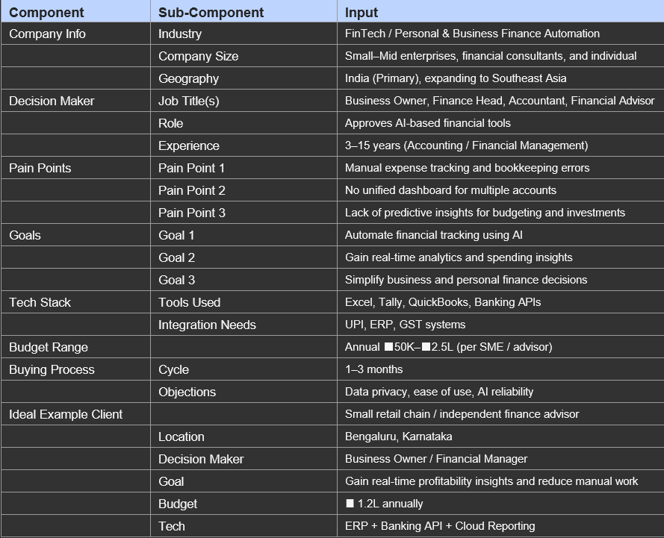
Ideal Customer Profile

Slide 8

Customer Persona
Rajesh Kumar
Age | 31 years
Occupation | MBA Graduate & Small Business Owner
Location | Bengaluru, India
Personality | Strategic, Disciplined, Tech-aware
Goals | Automate bookkeeping, get real-time cash flow insights, and use AI for smart investment planning.
Challenges | Manual tracking causes errors, hard to integrate multiple accounts, lacks financial transparency.
Motivation | Wants an AI-powered finance assistant to simplify analytics and improve decision-making.

Slide 9

Customer Persona
Ananya Singh
Age | 22 years
Occupation | Student (B.Tech – Final Year)
Location | Bengaluru, India
Personality | Independent, Curious, Practical
Goals | Track spending, create AI-based budgets, get reminders, and improve savings through smart suggestions.
Challenges | Hard to monitor UPI and card payments, forgets bill deadlines, lacks a unified view of finances.
Motivation | Wants an easy, intelligent finance tracker to manage expenses and build better money habits.

Slide 10

Customer Persona
Om Shukla
Age | 25 years
Occupation | Certified Financial Advisor
Location | Bengaluru, India
Personality | Analytical, Reliable, Goal-driven
Goals | Access consolidated dashboards, forecast spending patterns, and automate report generation.
Challenges | Manual data entry is time-consuming, syncing client data is difficult, and clients expect instant insights.
Motivation | Wants an AI-powered system to automate analytics, enhance accuracy, and deliver smarter financial insights efficiently.

Slide 11
Customer Interview Insights
The customer interviews revealed diverse financial management needs among young professionals and advisors.
Users are increasingly seeking AI-driven, time-efficient, and intuitive financial tools that simplify tracking, automate analysis, and provide actionable insights.
Customer | Overview | Key Insights | Summary
Ananya (22, Student) | A tech-savvy student managing rent, tuition, and expenses from part-time work and parental support | • Needs an app to track all transactions in one place.• Wants AI budgeting and saving suggestions | Ananya seeks a user-friendly AI tool that simplifies expense tracking and helps her form better financial habits.
Rajesh (31, Small Business Owner) | Runs retail stores and handles staff salaries and supplier payments. Struggles with analyzing profits and managing accounts manually. | • Wants automated bookkeeping.• Needs real-time cash flow tracking.• Desires AI-driven insights for smarter investments. | Rajesh needs an AI-powered finance dashboard to streamline cash flow management and improve business profitability.
Om (25, Financial Advisor) | Manages client portfolios and prepares reports manually. Faces time and data integration challenges. | • Seeks automated report generation.• Needs real-time financial analytics.• Wants a centralized dashboard for clients. | Om desires an AI-integrated financial assistant to automate analytics and improve client servicing efficiency.

Slide 12
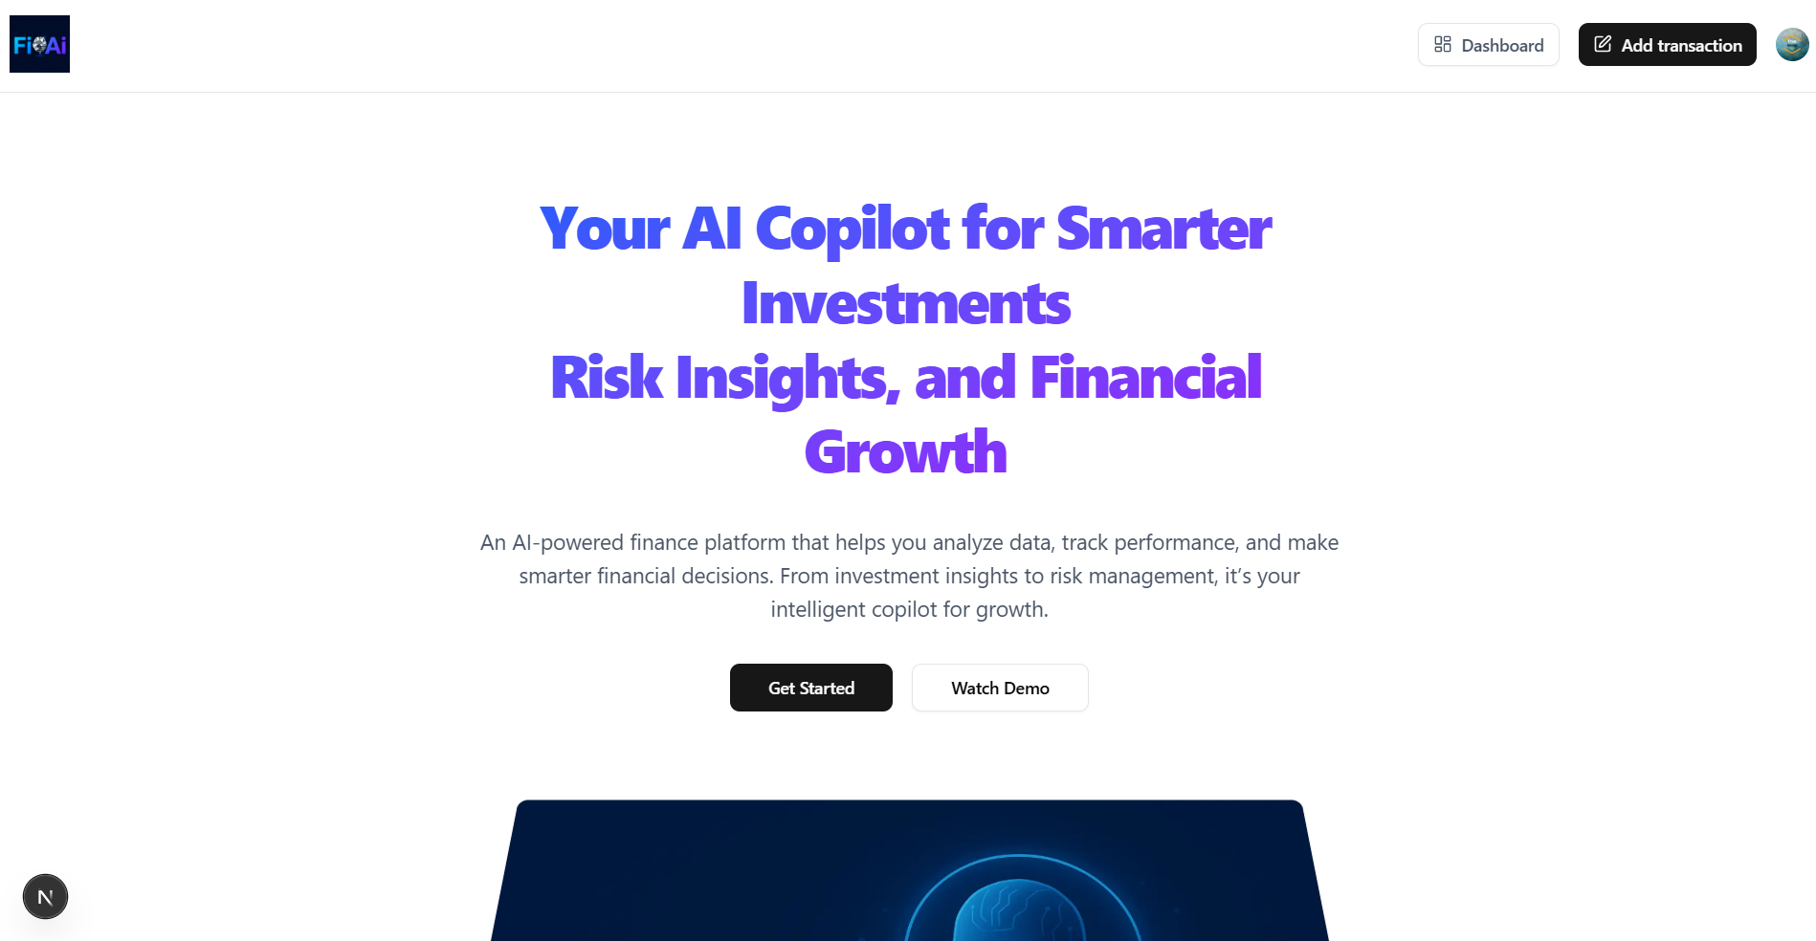
PROJECT PAGE

Slide 13
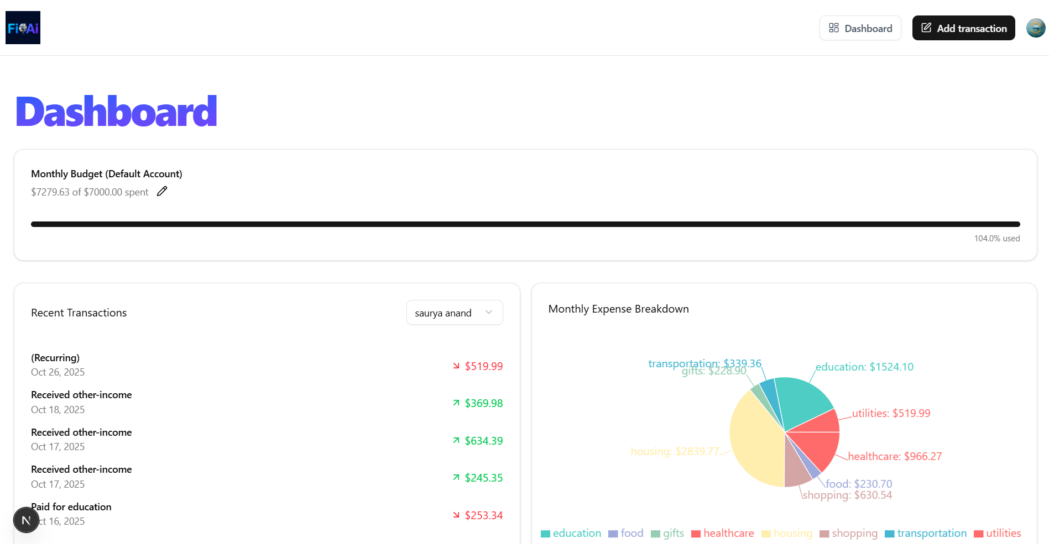
PROJECT PAGE

Slide 14
Product Requirement Specifications
Product Overview
Product Name: AI Finance Platform
Type: AI-powered full-stack web application
Purpose: To help users manage, analyze, and forecast their financial activities using AI insights. It automates budgeting, expense tracking, and investment recommendations through personalized dashboards.
Core Value: Simplifies personal and business finance management by leveraging Gemini AI for real-time analytics and smart decision-making.
Target Users: Individual investors, business owners, students, and financial advisors
System Architecture
Frontend: Next.js 15 + React 19 (Tailwind CSS, Shadcn UI)
Backend: Subspace (Serverless PostgreSQL) + Prisma ORM
Authentication: Clerk for secure user management
AI Engine: Gemini AI for budgeting, predictions, and analytics
Automation: Inngest for transaction updates and scheduled reports

Slide 15
Product Requirement Specifications
Functional Requirements
Feature | Description | Priority
User Authentication & Onboarding | Secure sign-up/login; collects user income, spending habit | High.
Finance Dashboard | Displays total balance, expenses, income trends | H i g h in
Expense Tracking | Users can add, edit, and categorize transactions automatic AI | Medium
Budget Planner | AI-generated monthly or custom budget recommendations | . High
AI Investment Insights | Provides stock, crypto, and savings suggestions based on pattern | Medium
Report Generation | Exports personalized financial reports to PDF or Excel. | Medium
Notifications & Reminders | Alerts for bill payments, budget limits, and savings milestones | Medium
Admin Portal | For monitoring usage analytics and managing users. | Low

Slide 16
Product Requirement Specifications
Non-Functional Requirements
Category | Requirement
Performance | App should respond within 2–3 seconds for key actions.
Scalability | Supports up to 20,000 active users simultaneously.
Security | Implements encryption, authentication (Clerk), and role-based access.
Usability | Responsive UI using Tailwind CSS and Shadcn UI.
Availability | 99% uptime with fallback and retry systems.
Integration | Supports Plaid API or financial data APIs for real-time balance updates.
Maintainability | Built using modular Next.js + Prisma architecture.
AI Integration | Uses Gemini AI for predictions and insights.

Slide 17
Product Requirement Specifications
Success Metrics
Risks and Mitigation Strategies
Metric | Target
User satisfaction rating | ³ 90%
Monthly active users | ³ 15,000
Budget planner usage | ³ 70% of users
AI prediction accuracy | ³ 85%
Report exports per user | ³ 2 per month
Risk | Impact | Mitigation
AI predictions may be inaccurate | Medium | Continuous model retraining and data validatio
User data privacy issues | High | Implement end-to-end encryption and GDPR
Third-party API downtime | Medium | Add caching and fallback mechanisms.
Low user retention | Medium | Personalized financial goals and regular insight

Slide 18
Team Size, Background, Strength /Capability and Resources
Team Overview
Category | Details
Team Size | 3 Members
Team Members | Saurya (Frontend Developer), Satyaprakash (Backend Developer), Srinivas (Integration & Deployment Engineer)
Background | Team of B.Tech students with experience in full-stack development, cloud integration, and AI-based financial applications.
Strength / Capability | Skilled in Java, Python, React, Node.js, and API integration. Strong collaboration and problem-solving abilities.
Resources | Development tools (VS Code, GitHub), cloud services (Firebase/AWS), and AI frameworks for finance analytics.

Slide 19
Team Roles and Responsibilities
Member Name | Role | Responsibilities
Saurya | Frontend Developer | Designs and develops the user interface using modern web technologies ensuring responsive and user-friendly design.
Satyaprakash | Backend Developer | Handles server-side logic, database management, and integration of AI features for financial data processing.
Srinivas | Integration & Deployment Engineer | Manages API integration, testing, and deployment of the application to ensure smooth performance and scalability.

Slide 20
Market Landscape - Market Potential, Competitors
Category | Details
Market Size (Total Spend) | The global personal finance software market was valued at USD 1.5 billion in 2024 and is expected to reach USD 2.5 billion by 2030, growing at a CAGR of around 8.5%.
Market Potential (Customer Base) | Based on ICP demographics — students, young professionals, and small business owners — the potential market includes over 120 million active users in India who use UPI, digital wallets, and online banking, representing a fast-growing tech-aware audience
Competitors | Key competitors include Walnut, Money Manager, ET Money, INDmoney, and Google Pay Insights. These platforms offer expense tracking and investment management but often lack deep AI-driven personalization and automation.
Uniqueness / Competitive Advantage | AI Finance Assistant stands out through: • Smart AI analytics that predict spending patterns and suggest saving strategies. • Unified dashboard combining personal and business finance in real time..

Slide 21
Business Model & Strategy
🧩 Revenue Model
Freemium Model: Basic features free, premium AI tools under subscription
Subscription Plans:
  Monthly: ₹199 / user
  Annual: ₹1,799 / user
Enterprise/B2B Licensing: For financial advisors & SMEs
Ad-Based Revenue: From partner fintech integrations and insights dashboards
Year | Estimated Users | Revenue (INR) | Growth
Year 1 | 5,000 | ₹12 Lakh | –
Year 2 | 20,000 | ₹60 Lakh | ↑ 5x
Year 3 | 60,000 | ₹2.1 Crore | ↑ 3.5x
Year 4 | 1.5 Lakh | ₹5.4 Crore | ↑ 2.5x
Year 5 | 3 Lakh | ₹10+ Crore | ↑ 2x

Slide 22
Business Model & Strategy
Business Model
B2C: Individual users (students, professionals) subscribe directly
B2B: Partner with fintech firms, banks, and business service platforms
AI Insights API: Offered to financial startups for white-label solutions
Channels
Online App Stores: Google Play, iOS
Website Subscription Portal
Corporate Partnerships (banks, educational institutes)
Digital Marketing: Influencer and content-based promotions
Revenue Sharing
App Store: 70% company / 30% platform fee
Enterprise Deals: 80% company / 20% channel partner
Ad & Affiliate Revenue: Shared 60–40 with partner brands

Slide 23
Required Support and Regulation
🟩
🧩 Required Support
💻 Technical: Access to AI APIs, cloud hosting credits, and development tools
💵 Financial: Seed funding or incubation grants for scaling the MVP
🧠 Mentorship: Guidance from fintech and startup ecosystem experts
🏢 Incubation: Workspace, testing environment, and networking support

